Slide 1
Time Dependency:
An Inconvenient Truth
By Andrew J. Hyett, Ph.D.
20 years of monitoring rock displacement in mines

Slide 2
What is a borehole extensometer?
A borehole extensometer comprises an array of rods terminated at “anchor points” which measure the movement of those anchor points RELATIVE to the instrumentation head.
The device can be used to measure the axial components of borehole movements when it is cemented in a borehole

Slide 3
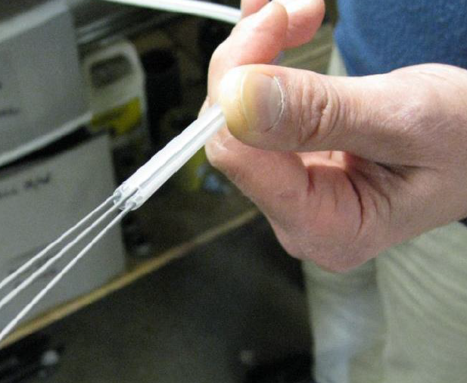
d_EXTO: The Guts

Slide 4
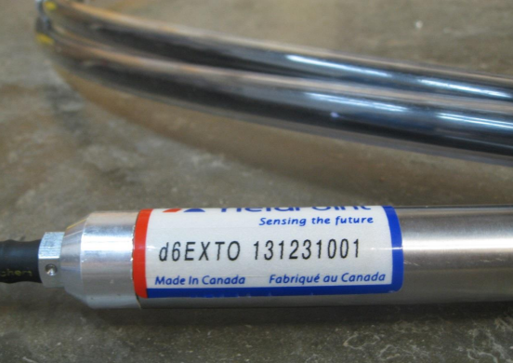
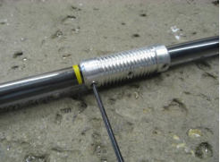
d_EXTO: Borehole Extensometer
Head
Anchor Point

Slide 5
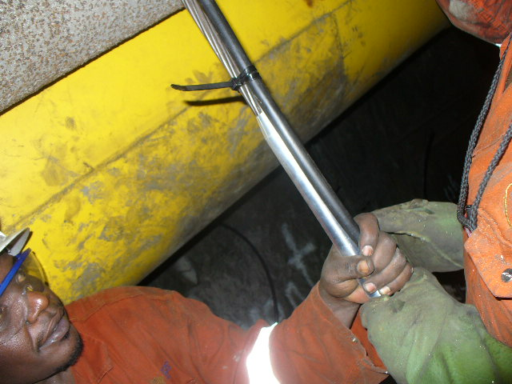

Slide 6
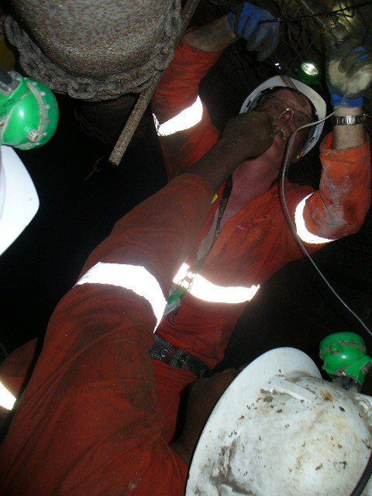

Slide 7
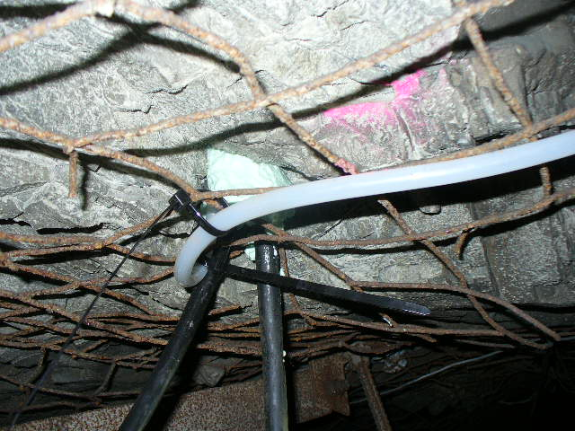

Slide 8
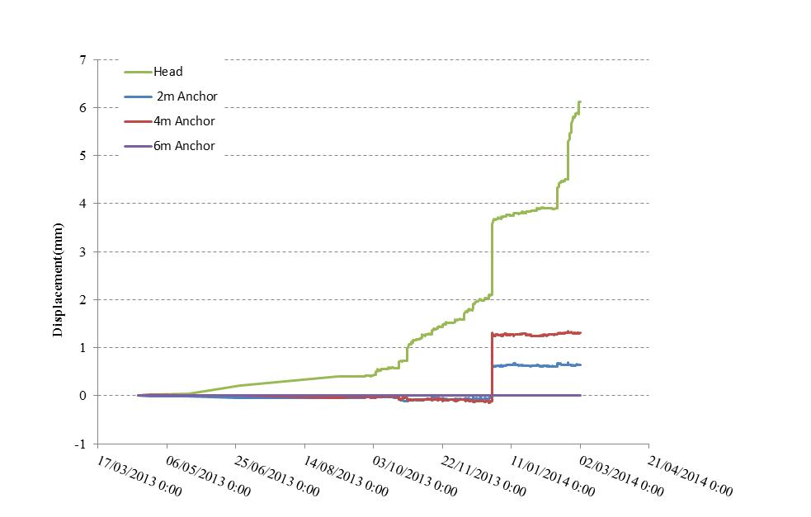
7800 Level Creighton Mine, Sudbury

Slide 9
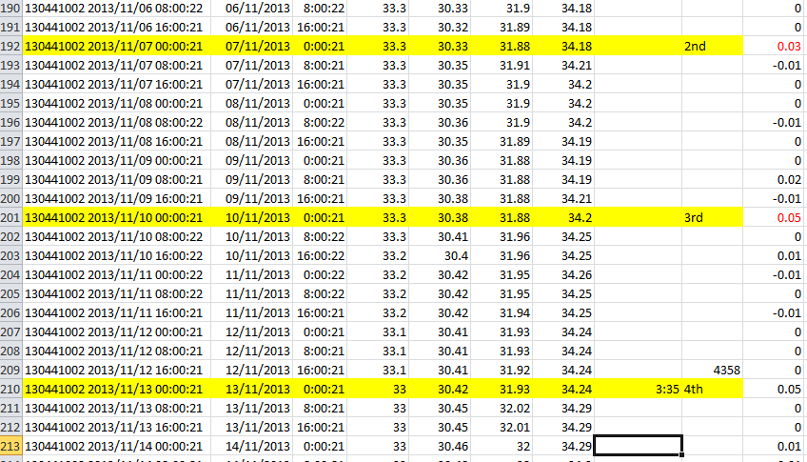

Slide 10
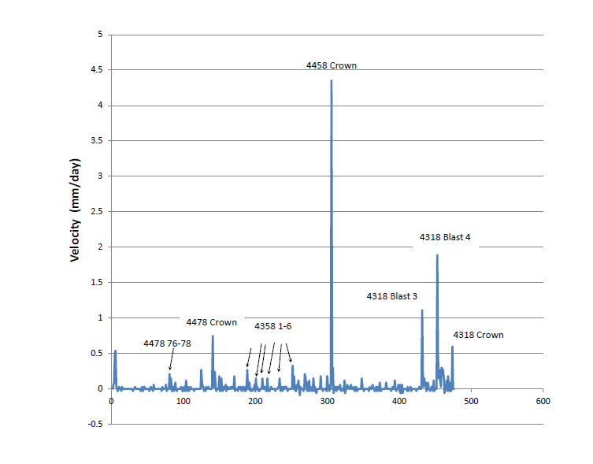

Slide 11
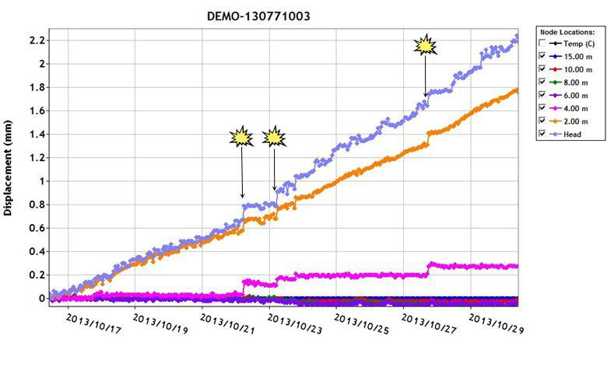
Head at Collar d_EXTO: Rock Movements

Slide 12
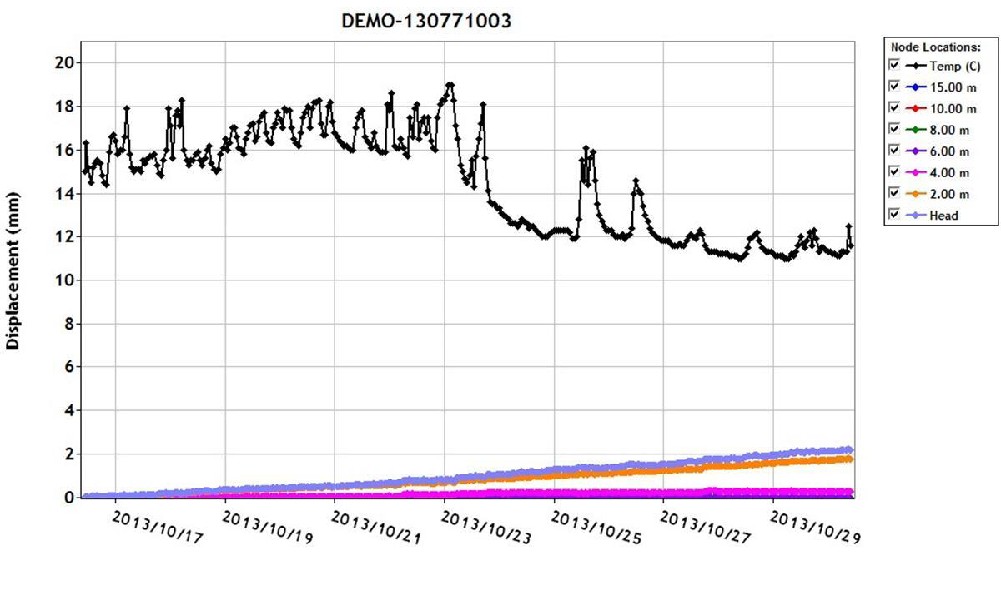

Slide 13
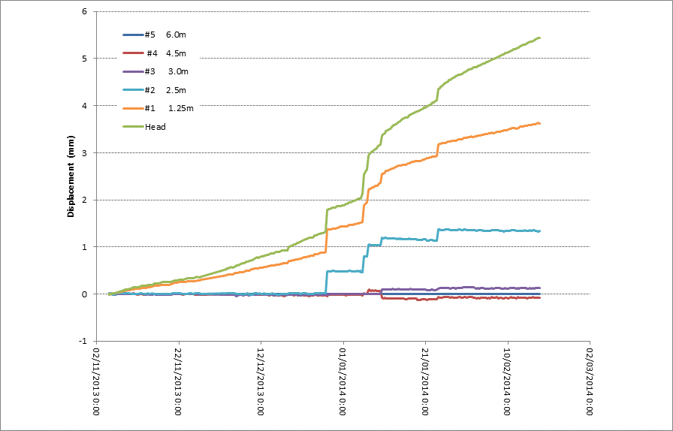
Rock Movement: Kristineberg: Lithology 1

Slide 14
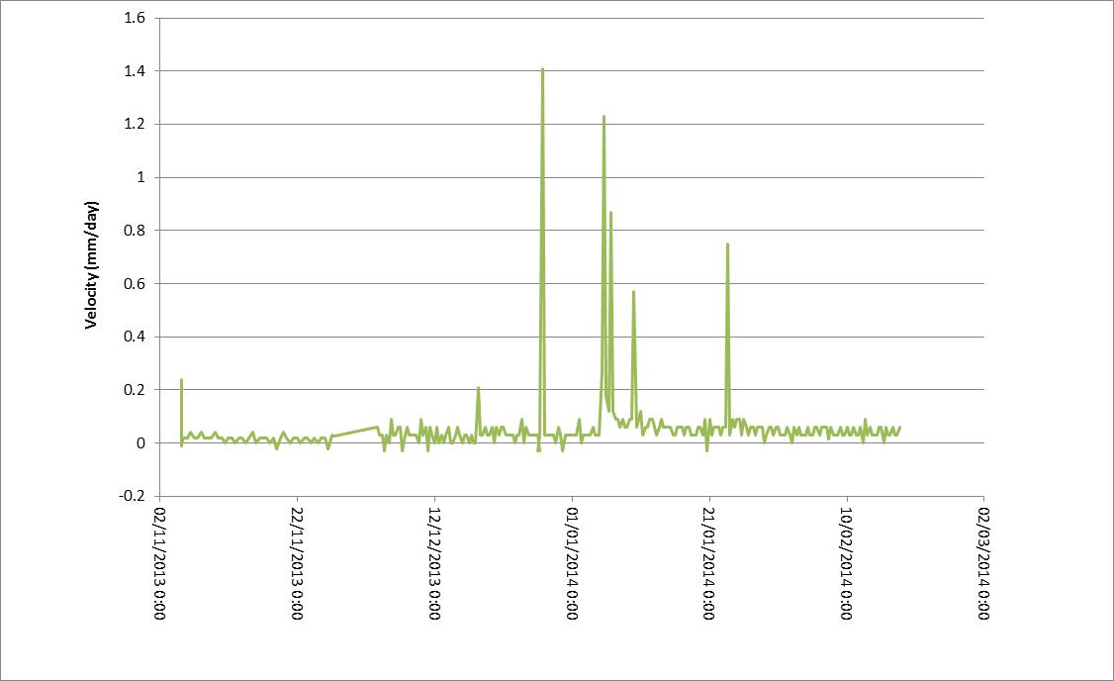
Rock Velocity: Kristineberg: Lithology 1

Slide 15
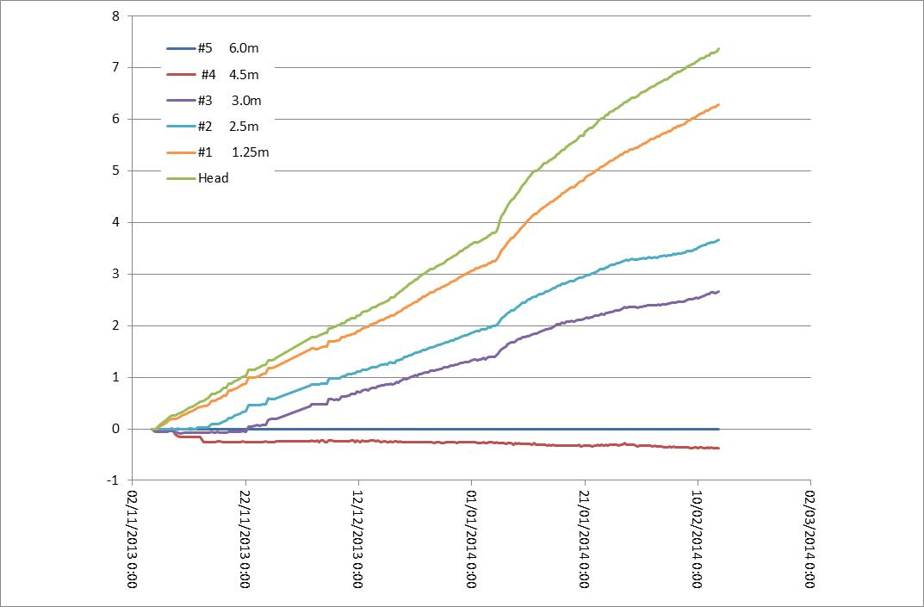
Rock Movement: Kristineberg: Lithology 2

Slide 16
Rock Velocity: Kristineberg: Lithology 2

Slide 17
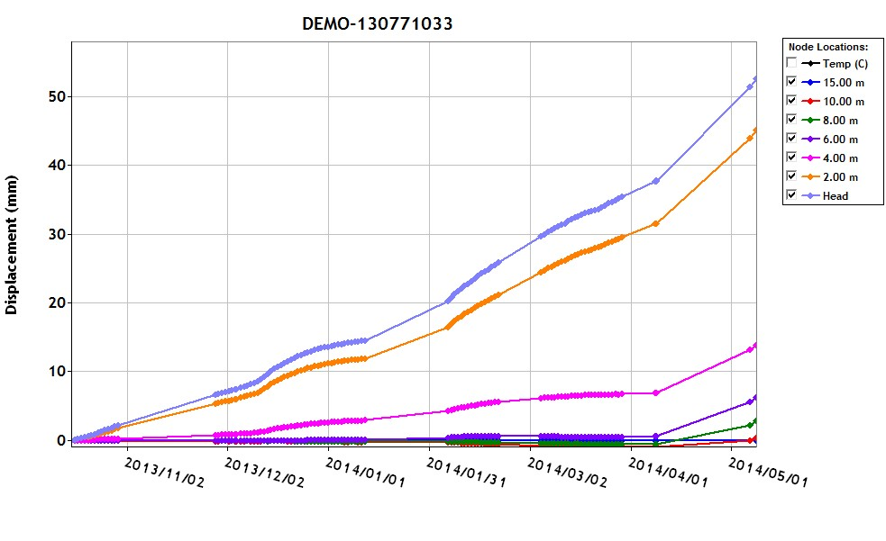
Quebec Canada: Rock Movements

Slide 18
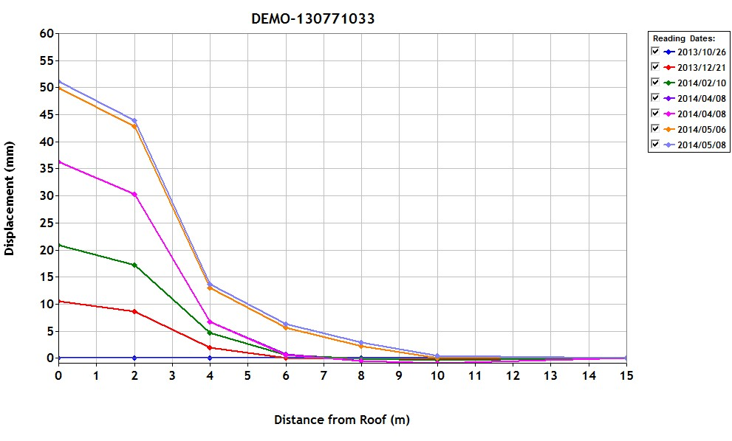

Slide 19
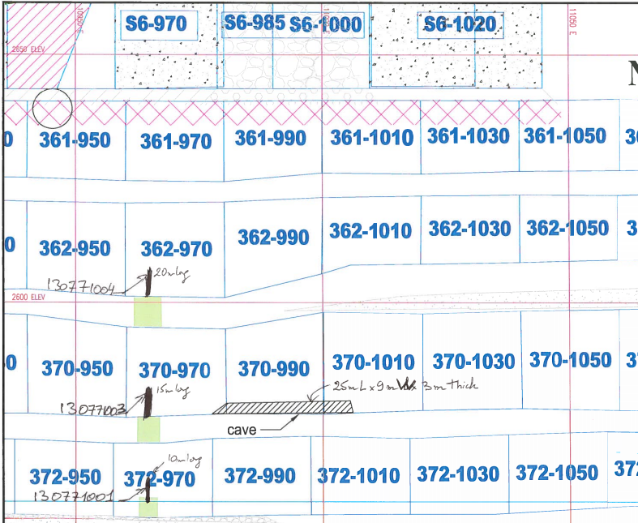

Slide 20
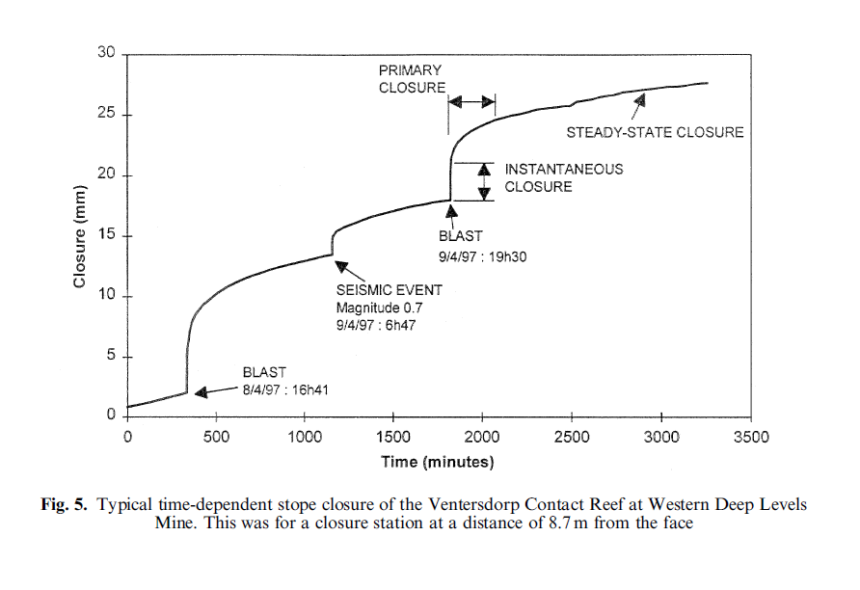
After (Malan,1999)

Slide 21
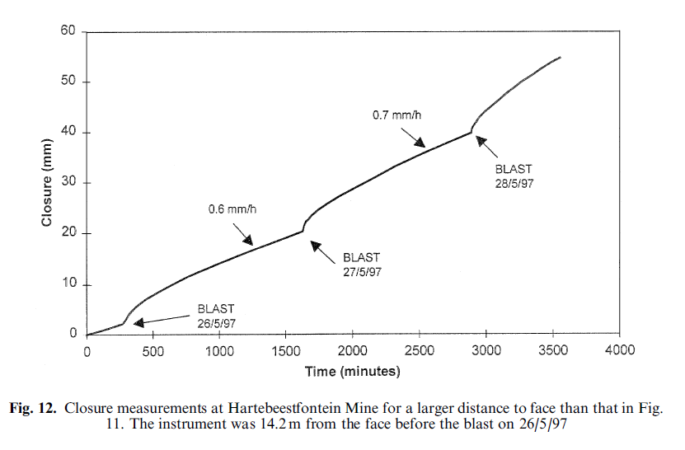
After (Malan,1999)

Slide 22
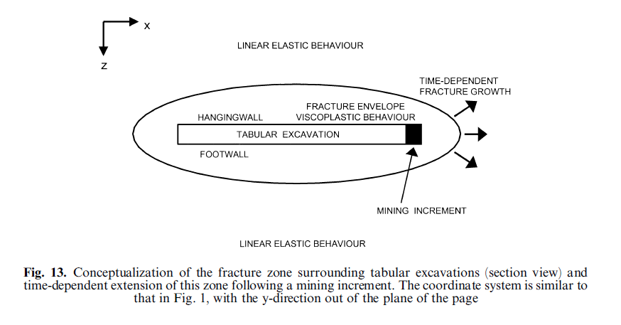
After (Malan,1999)

Slide 23
POINTS TO DISCUSS:
Teminology, Nomenclacture
Excavation closure convergence, rock mass closure convergence??
Application to bulk mining methods,
Correlation with micro-seismicity database,
Underlying rock physics
Modelling approaches.
FLAC in visco-plastic mode.
RocScience visco-plasticity code??
New visco-plastic code for excavation support design
Rock mass characterization to determine visco-plastic parameters

