Slide 1

Enlightening Bolts
Using Distributed Optical Sensing (DOS) to Measure the Strain Profile along Fully Grouted Rock Bolts
A.J.Hyett¹ F.C Charette² B.J. Forbes¹ AC Engbretson¹
YieldPoint Inc.
Normet 0y.

Slide 2
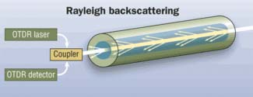
Principle of Measurement
Strain or temperature in the cable result in elevated backscatter

Slide 3
Packaging for Mining
Developing a prototype
Diametrically opposed grooves along the length of a Rebar Bolt
Route a looped single fiber- optic instrumentation along the grooves in Rebar

Slide 4
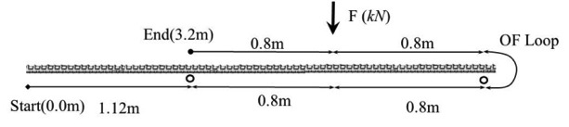
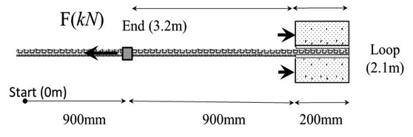
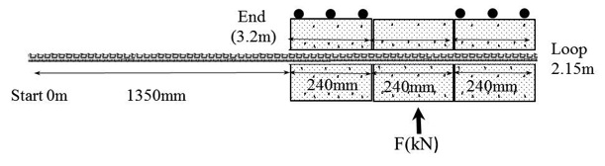
Prototypical Testing
Point Load Bending (Symmetric and Cantilever)
Axial Pull-Test (Short Embedded Length)
Double Shear Configuration

Slide 5
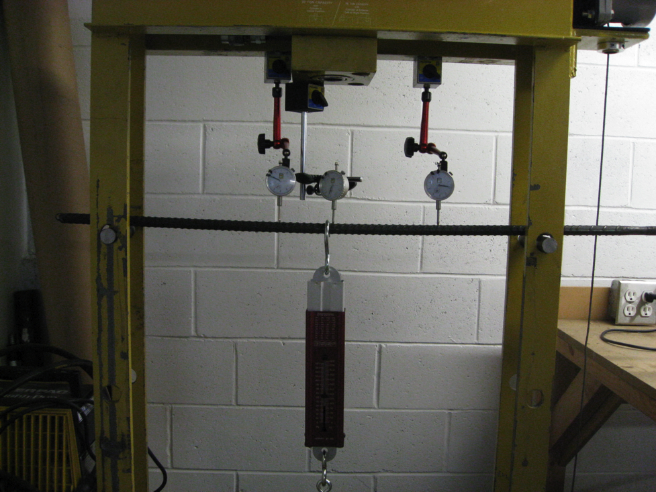
Symmetric Point Load

Slide 6
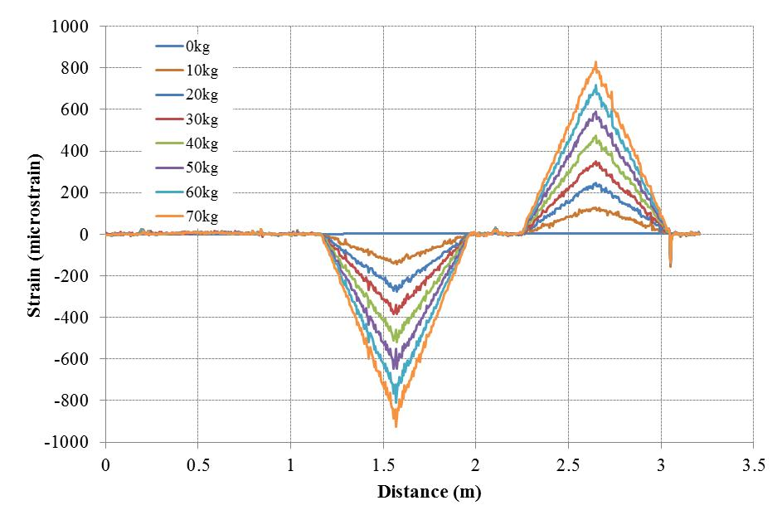
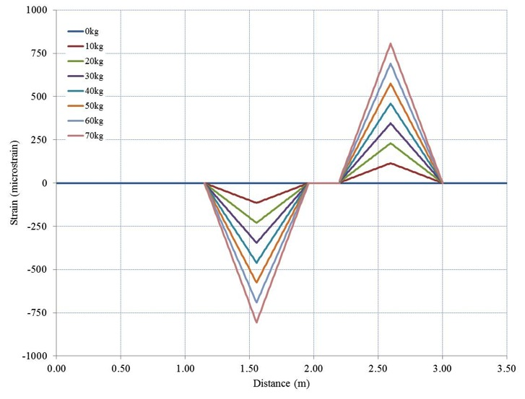
Symmetric Point Load
Experiment
Theory

Slide 7
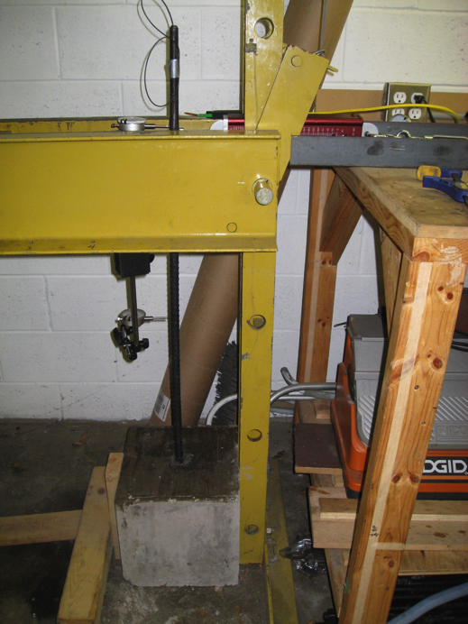
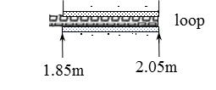
Cantilever Load
Direction of applied load
0.2m Embedment length in concrete block (held in place)

Slide 8
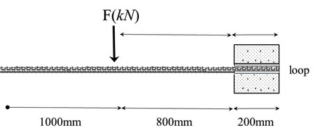
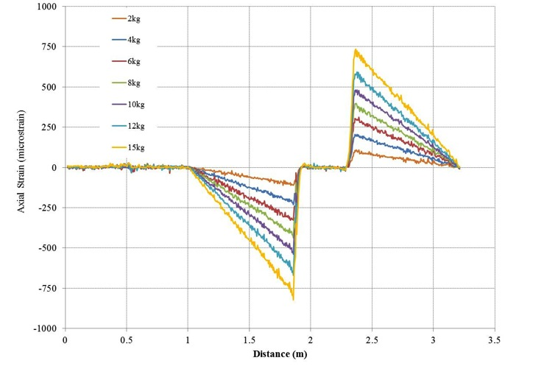
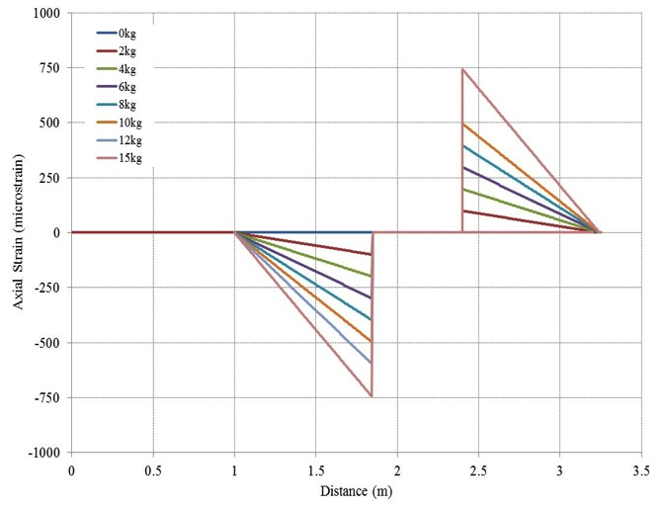
Cantilever Load
Experiment
Theory

Slide 9
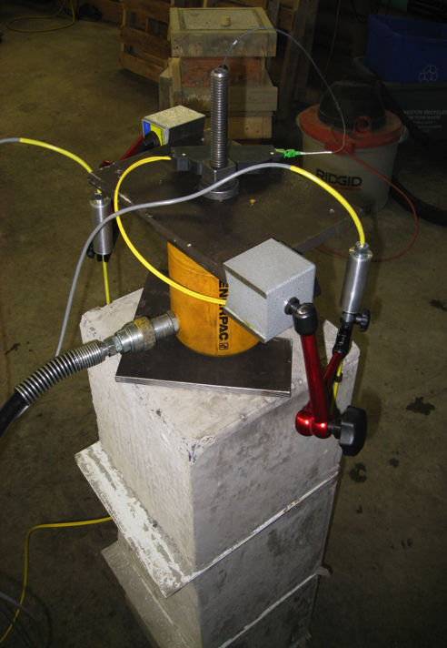
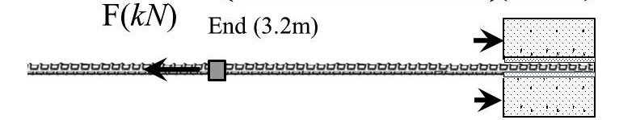
Pull-Test

Slide 10
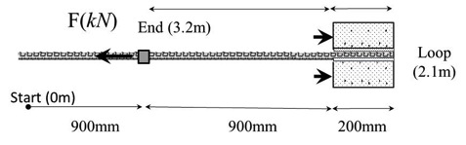
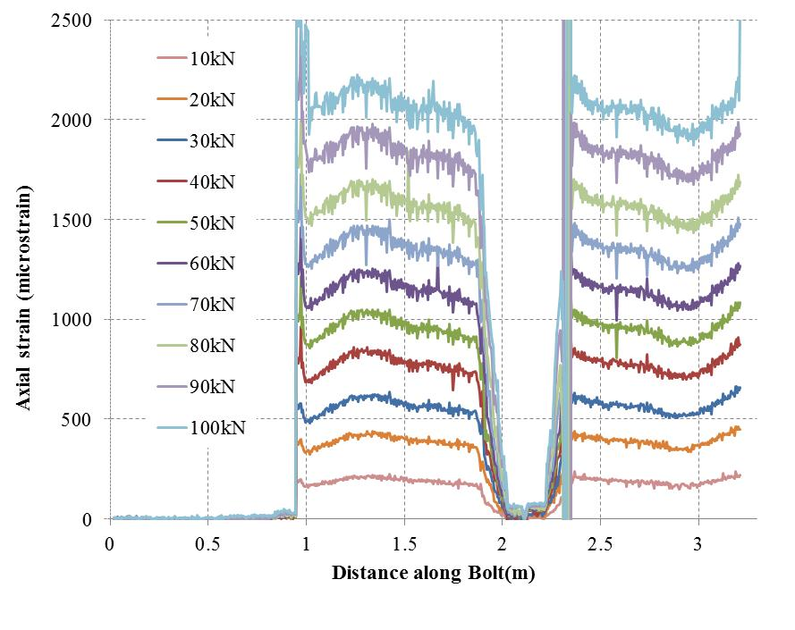
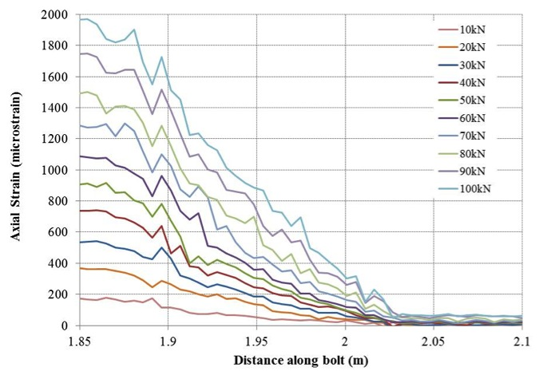
Pull-Test
Full Length
Embedment Length

Slide 11
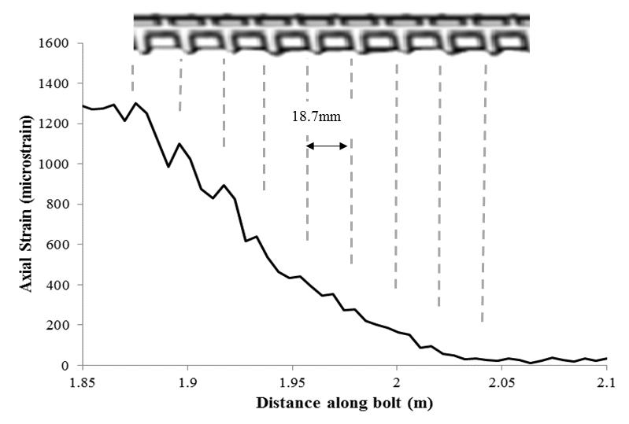
Pull-Test

Slide 12
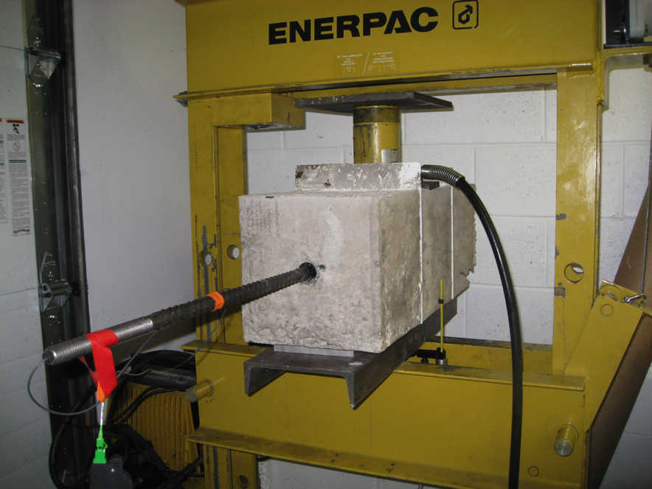
Double Shear Configuration
Direction of applied force

Slide 13
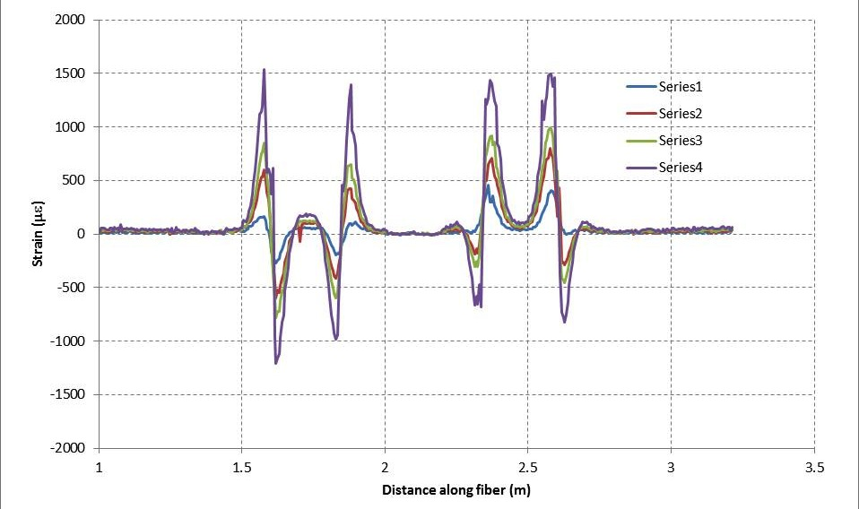
Shear Couplet

Slide 14
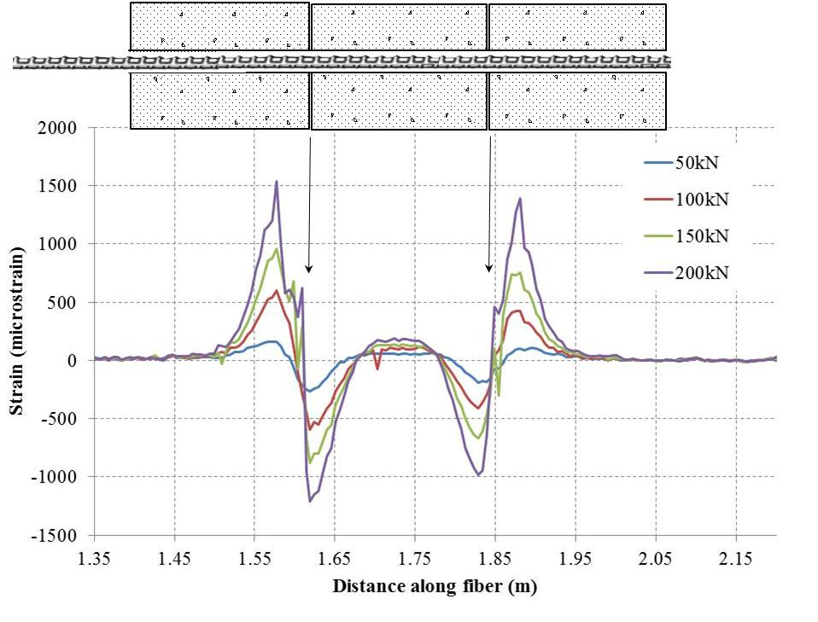
Double Shear Configuration

Slide 15
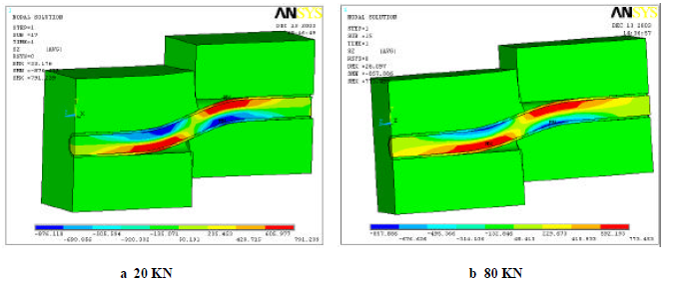
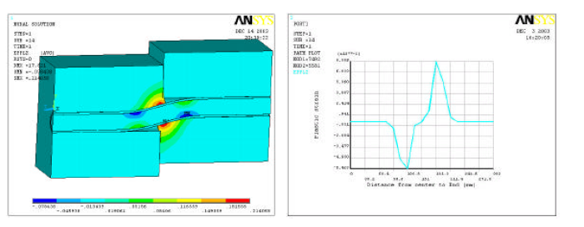
After Jalalafar (2006)

Slide 16
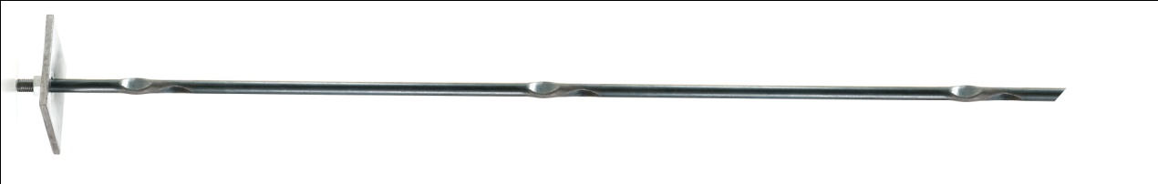
Tests on Normet’s D-Bolt
130mm
F (kN)
600mm
550mm

Slide 17
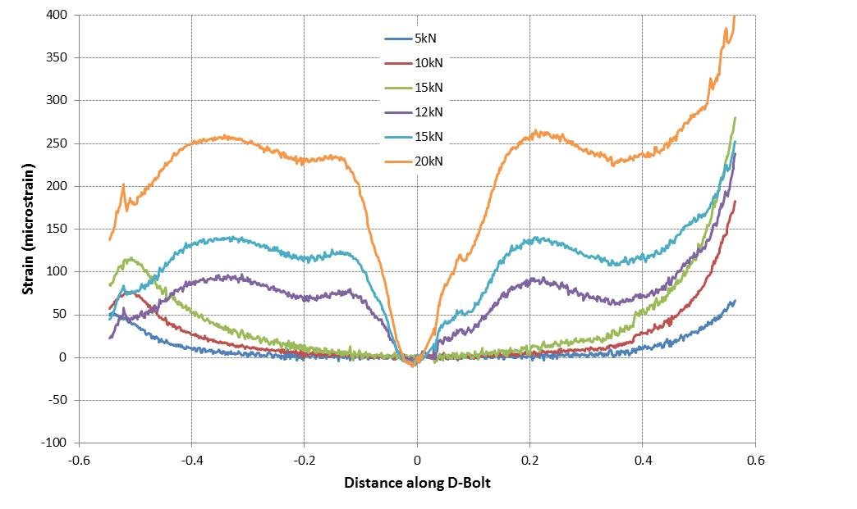
Loop
Top fiber
Bottom fiber

Slide 18
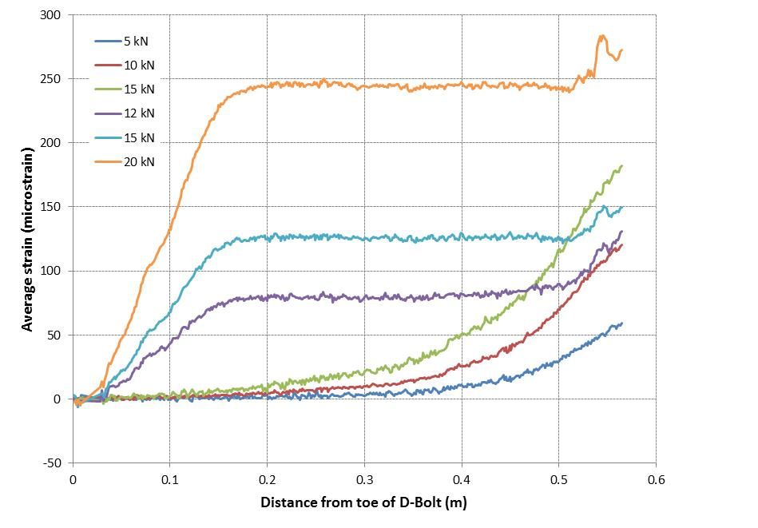

Slide 19
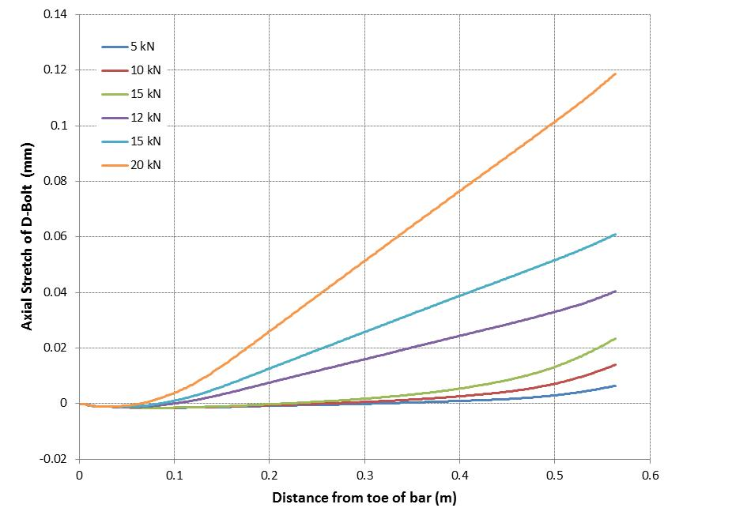
Intergrate strain over bar length = Displacement
Adhesion

Slide 20
After Farmer (1975)

Slide 21
differentiate Strain = Traction at Bolt grout interface
Paddles

Slide 22
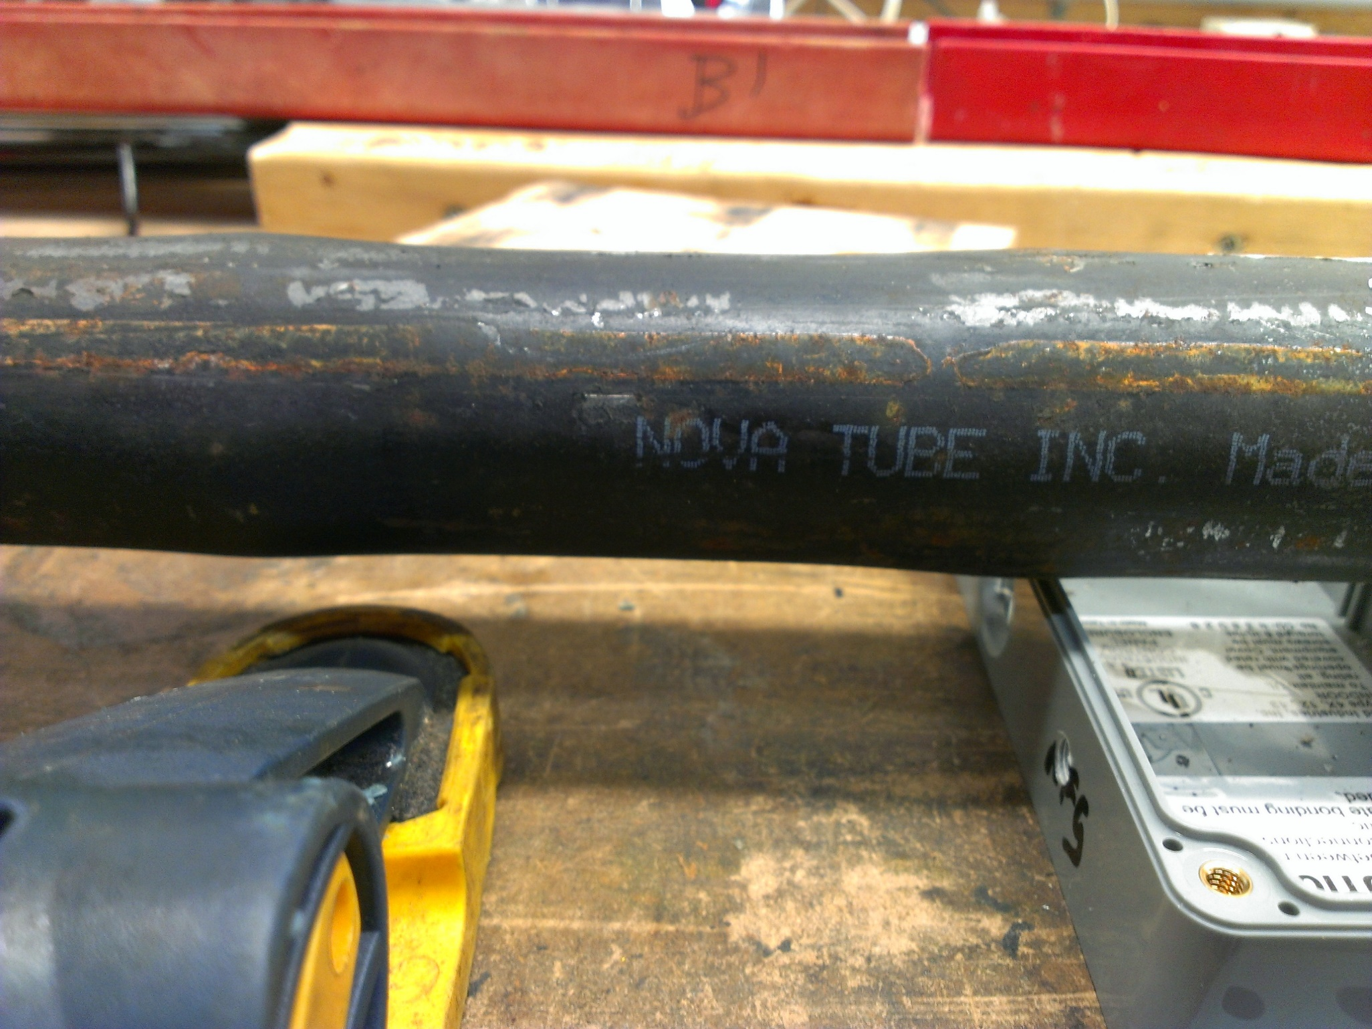

Slide 23
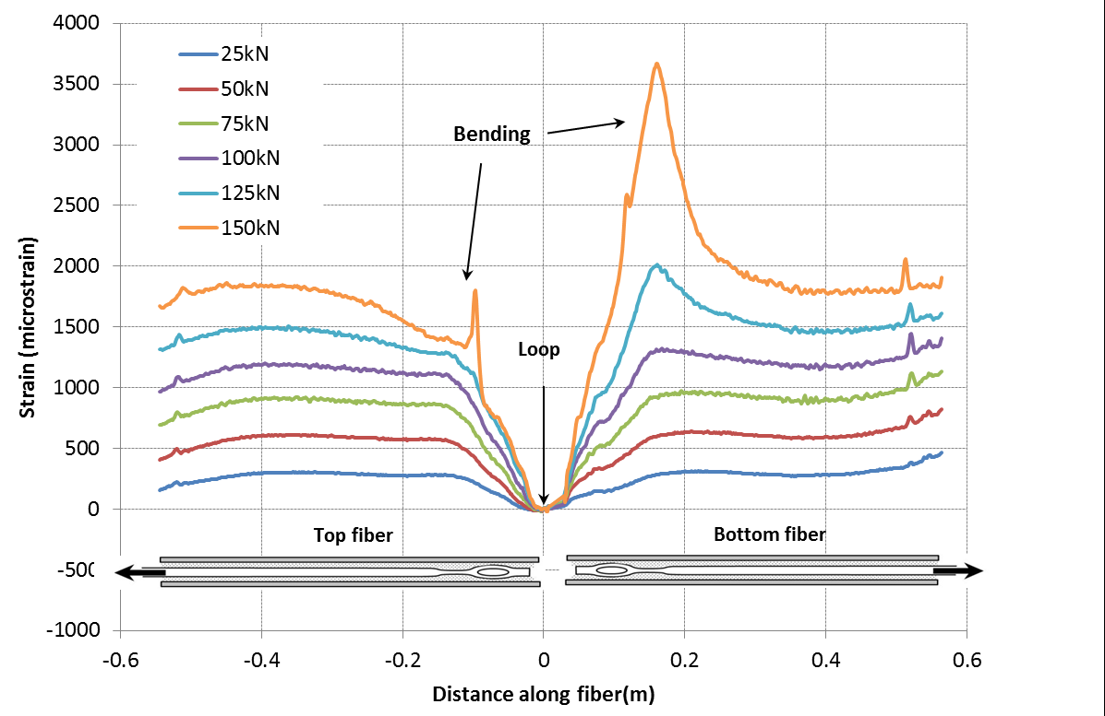

Slide 24
ASTM F432 Testing

Slide 25
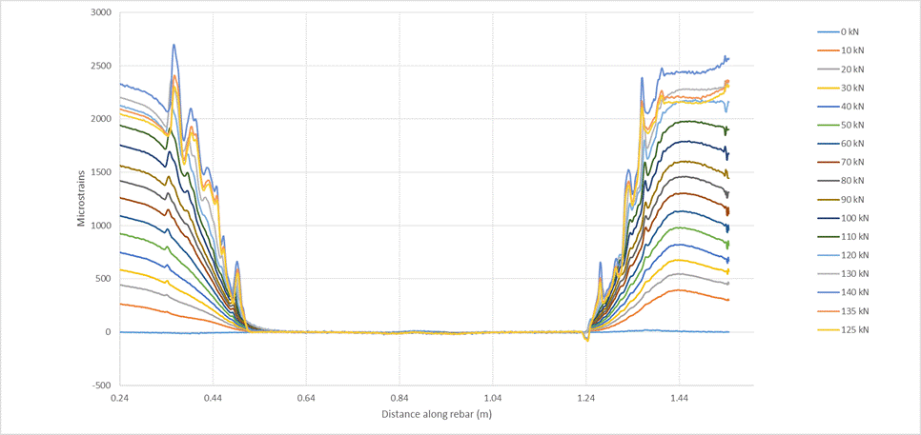
ASTM F432 DOS Results

Slide 26
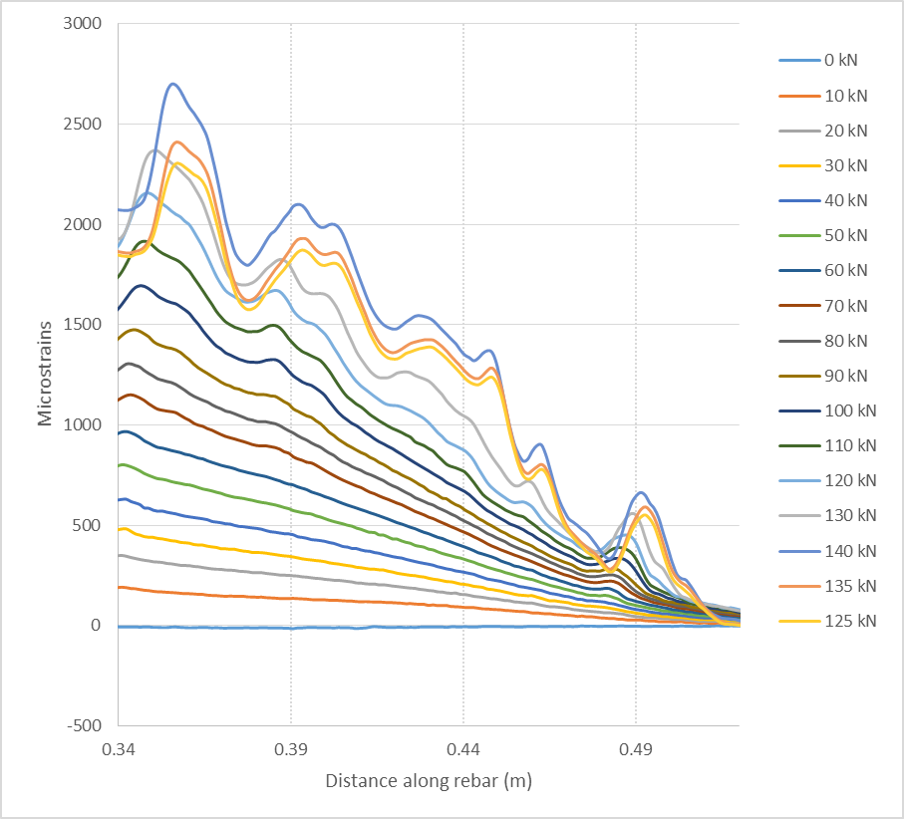

Slide 28
Conclusions
Viable technology for research into fundamental rock bolt behavior.
Output data from experiments compare within ± 5% of theory.
The shape of experiment and theory plots are essential identical
Future Work: Applications to rock mass monitoring eg. Pillar monitoring + many more applications
So I invite you to fantasize then drop us an e-mail.

